Slide 1
DIGITAL VIDEO INTERFACE

Slide 2
Agenda
What is DVI?
How it works?
Types Of DVI cable
What are SINGLE AND DUAL LINKS ?
DVI Maximum length/How do I know which cable to use?
How to recognize a DVI Cable?

Slide 3
What is DVI?
DVI is a popular form of video interface technology made to maximize the quality of flat panel LCD monitors and modern video graphics cards.
It is a replacement for the Plug & Display standard, and a step up from the digital-only DFP format for older flat panels.
DVI cables are becoming increasingly popular with video card manufacturers, and most cards nowadays include both a VGA and a DVI output port.

Slide 4
What are the formats?
There are three types of DVI connections:
  DVI-Digital, DVI-Analog, and DVI-Integrated (Digital & Analog)
    DVI-D - True Digital Video
    DVI-A - High-Res Analog
    DVI-I - The Best of Both Worlds

Slide 5
DVI-D - True Digital Video
DVI-D cables are used for direct digital connections between source video (namely, video cards) and digital LCD (or rare CRT) monitors.
This provides a faster, higher-quality image than with analog, due to the nature of the digital format.
All video cards initially produce a digital video signal, which is converted into analog at the VGA output.
The analog signal travels to the monitor and is re-converted back into a digital signal.
DVI-D eliminates the analog conversion process and improves the connection between source and display.

Slide 6
DVI-A - High-Res Analog
DVI-A cables are used to carry a DVI signal to an analog display, such as a CRT monitor or budget LCD.
The most common use of DVI-A is connecting to a VGA device, since DVI-A and VGA carry the same signal.
There is some quality loss involved in the digital to analog conversion, which is why a digital signal is recommended whenever possible.

Slide 7
DVI-I - The Best of Both Worlds
DVI-I cables are integrated cables which are capable of transmitting either a digital-to-digital signal or an analog-to-analog signal.
This makes it a more versatile cable, being usable in either digital or analog situations. Like any other format, DVI digital and analog formats are non-interchangeable. This means that a DVI-D cable will not work on an analog system, nor a DVI-A on a digital system. To connect an analog source to a digital display, you'll need a VGA to DVI-D electronic convertor; to connect a digital output to an analog monitor, you'll need to use a DVI-D to VGA convertor.

Slide 8
What are SINGLE AND DUAL LINKS?
The Digital formats are available in DVI-D Single-Link and Dual-Link as well as DVI-I Single-Link and Dual-Link format connectors.
These DVI cables send information using a digital information format called TMDS (transition minimized differential signaling). Single link cables use one TMDS 165Mhz transmitter, while dual links use two.
The dual link DVI pins effectively double the power of transmission and provide an increase of speed and signal quality; i.e. a DVI single link 60-Hz LCD can display a resolution of 1920 x 1200, while a DVI dual link can display a resolution of 2560 x 1600.

Slide 9
DVI MAXIMUM LENGTH/HOW DO I KNOW WHICH CABLE TO USE?
The official DVI specification mandates that all DVI equipment must maintain a signal at 5 meters (16 feet) in length. But many manufacturers are putting out much stronger cards and bigger monitors, so the maximum length possible is never exact.
If one or both connections are DVI-D, you need a DVI-D cable.
If one or both connections are DVI-A, you need a DVI-A cable.
If one connection is DVI and the other is VGA, and the DVI is analog-compatible, you need a DVI to VGA cable or a DVI/VGA adaptor.
If both connections are DVI-I, you may use any DVI cable, but a DVI-I cable is recommended
If one connection is analog and the other connection is digital, there is no way to connect them with a single cable.

Slide 10
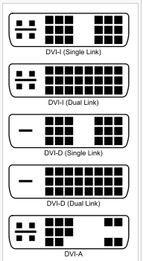
How to recognize a DVI Cable?

Slide 11
Advantages of DVI over existing analog interfaces
The Speed is one advantage of DVI. A maximum of 5 gigabits per second.
Picture quality in DVI is crystal clear and in deep color means that 30 bit, 36 bit, and 48 bit colors are used in the display
DIFFERENCE Between HDMI and DVI
HDMI in introduced to over come the DVI because DVI only support Video but HDMI support both audio and video.
HDMI technology incorporates content security that is called High Definition Content Protection, also known as HDCP

Slide 12
DVI Quality
DVI, on the other hand, are digital. They use information in the form of ones and zeros.
This information travels through cables as distinct electrical pulses
an aspect ratio of 16:9, so the picture is rectangular
The resolutions of up to 1920 x 1080 pixels.
DVI signals can also be progressive
The DVI standard for creating high-bandwidth connections between digital devices.

Slide 13
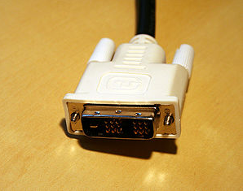
DVI CABLE

Slide 14
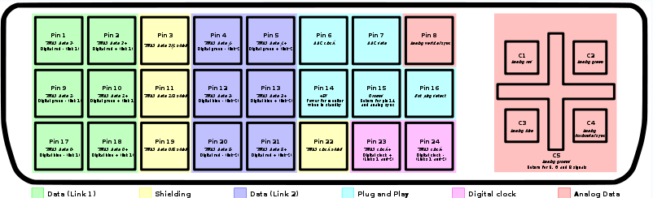
DVI CABLE

Slide 15
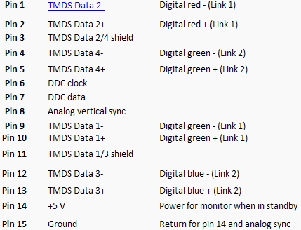
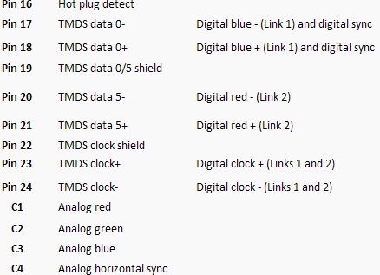
DVI CABLE

Slide 16


